Slide 1

Capstone Project: Netflix Data

Slide 2
List of Visualizations
Distribution of 2017 Netflix Stock Prices by Quarter
Earnings Per Share
Revenue vs. Earnings
Stock Price Developement Netflix vs. Dow Jones

Slide 3
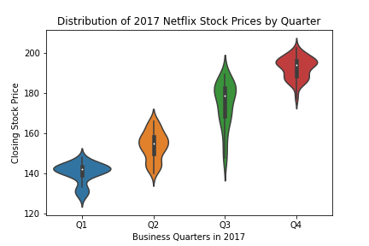
Distribution of 2017 Netflix Stock Prices by Quarter
Representative violine plot for each quarter of 2017 to compare
KDE
median
interquartile range
confidence intervalls

Slide 4
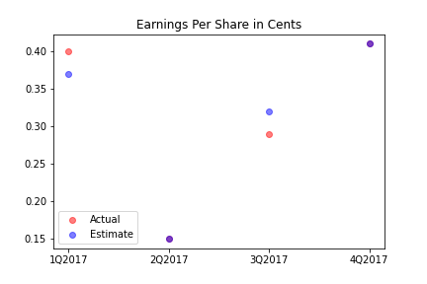
Earnings Per Share
Correlation between actual earnings (red) and estimated earnings (blue)

Slide 5
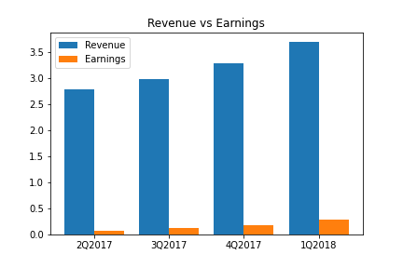
Revenue vs. Earnings
Side-by-side boxplot to compare revenue to earnings for different quarters

Slide 6
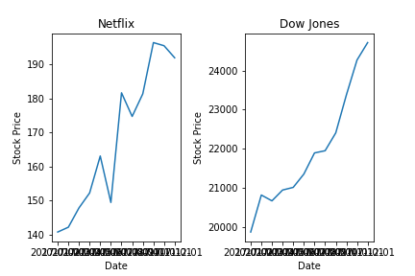
Stock Price Developement Netflix vs. Dow Jones
Development of the stock price for netflix compared to the stock prices of the Dow Jones

